Slide 1


Slide 2
Panzer Dragoon: Remake Nintendo Direct reveal:
https://www.youtube.com/watch?v=yjCivsV8qwU&t=1s

Slide 4
Panzer Dragoon: Remake gampeplay trailer:
https://www.youtube.com/watch?v=QiqnBXlOOhs&t=1s

Slide 6


Slide 7
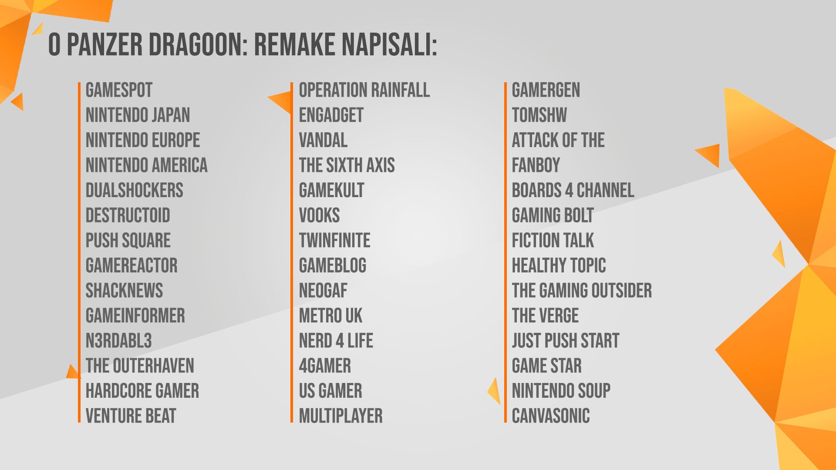

Slide 8
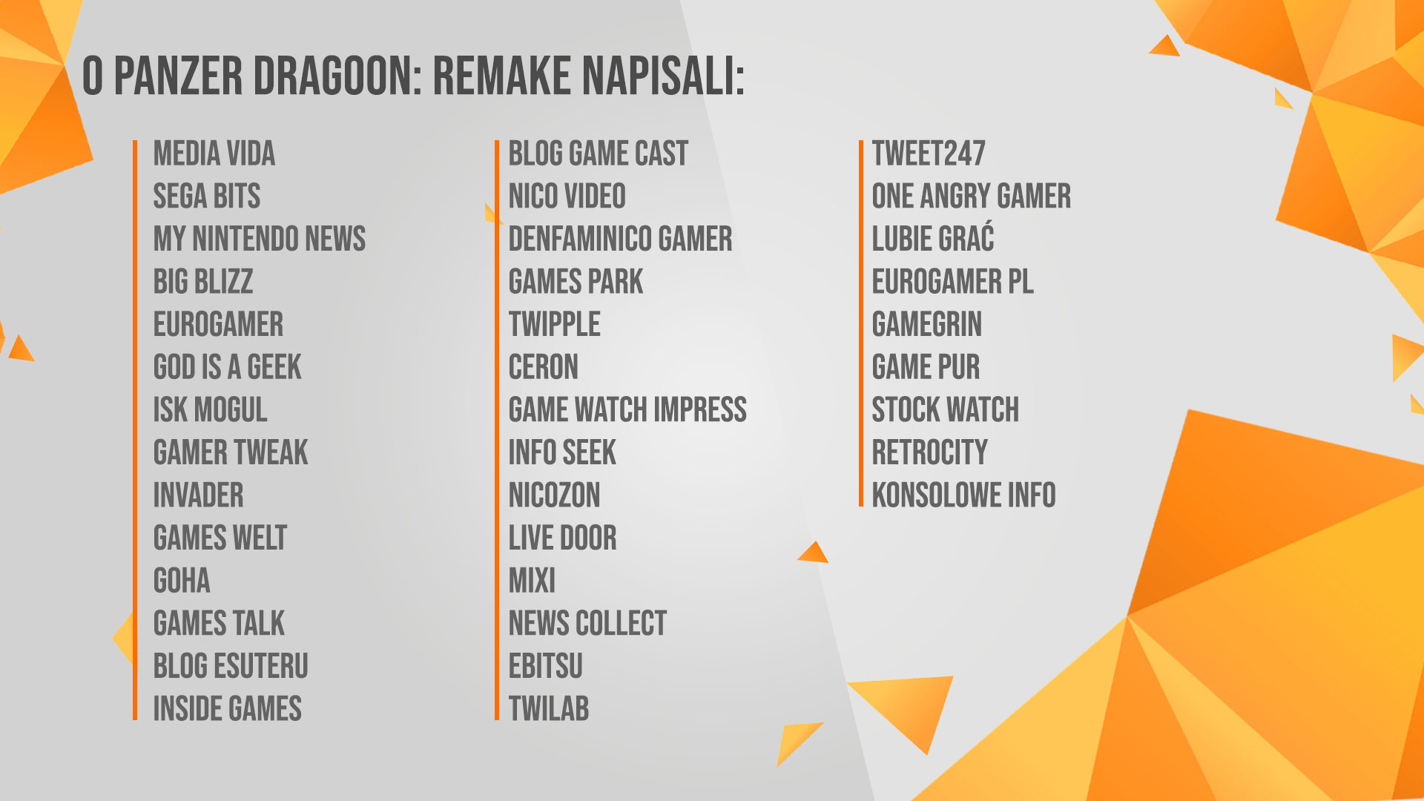

Slide 9


Slide 10
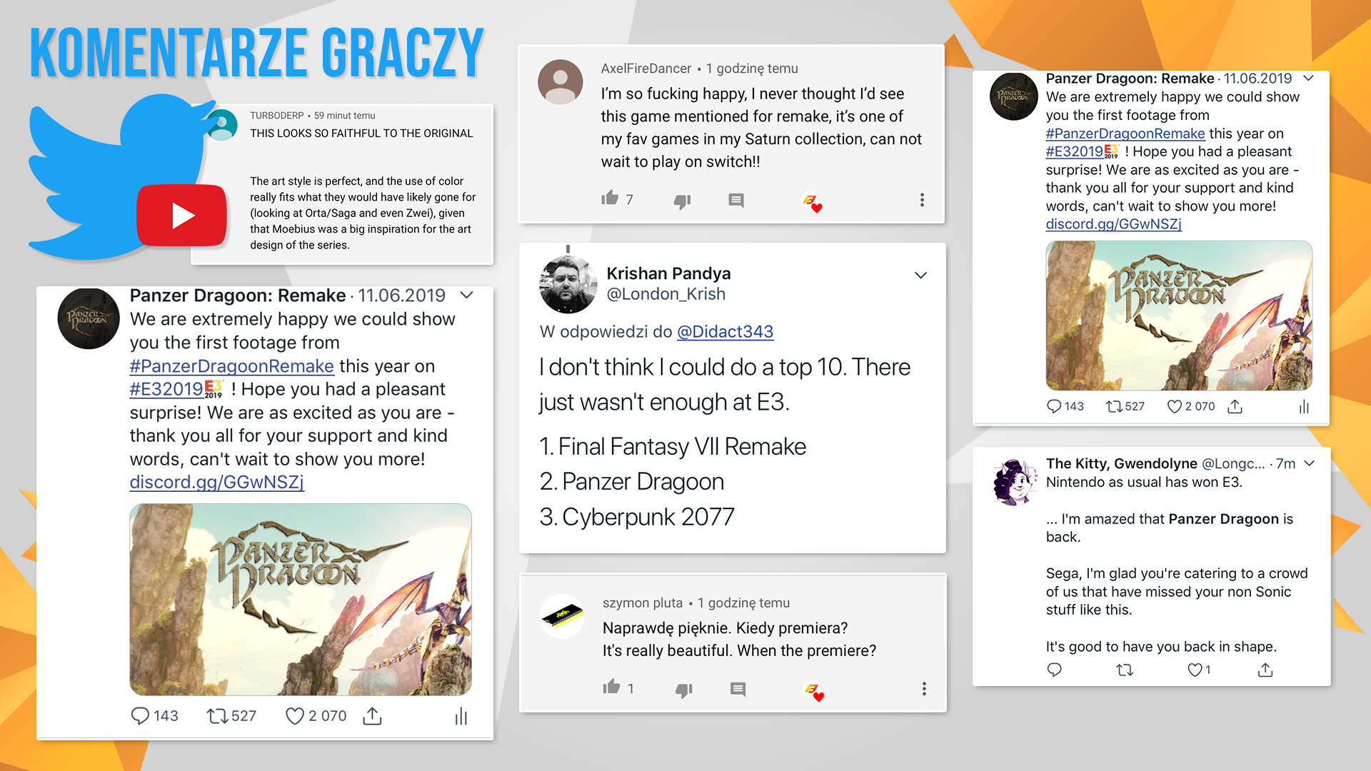

Slide 11
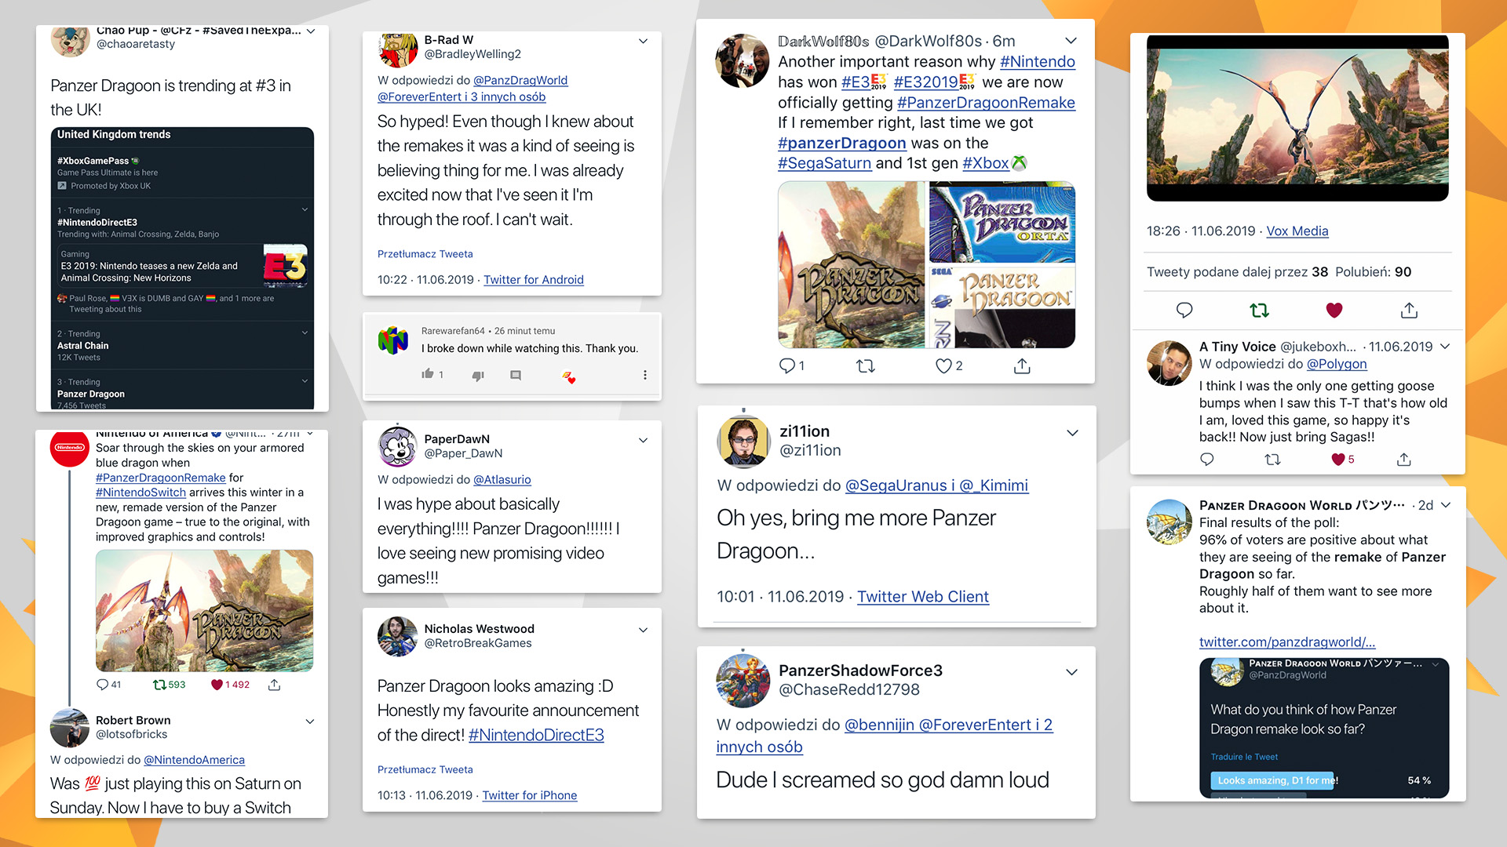

Slide 12
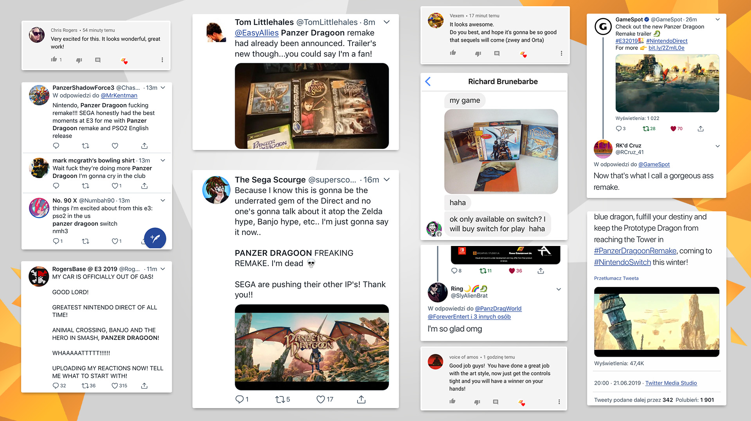

Slide 13
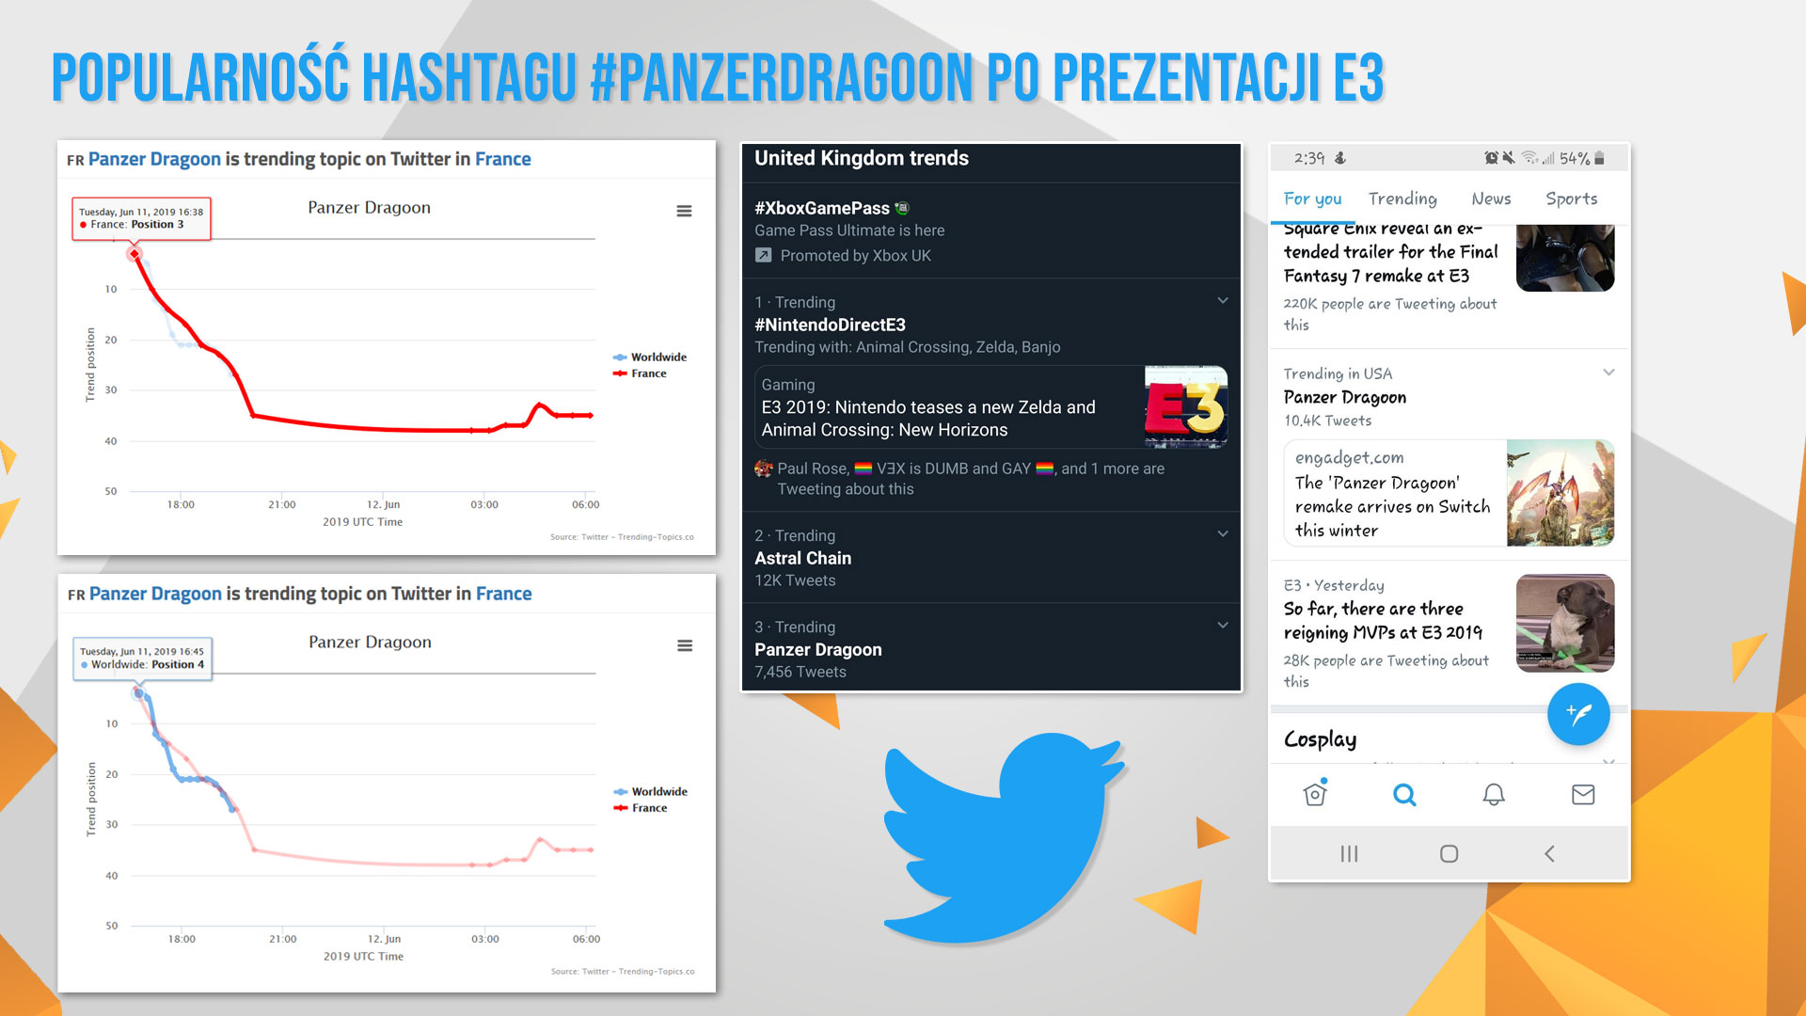

Slide 14


Slide 15
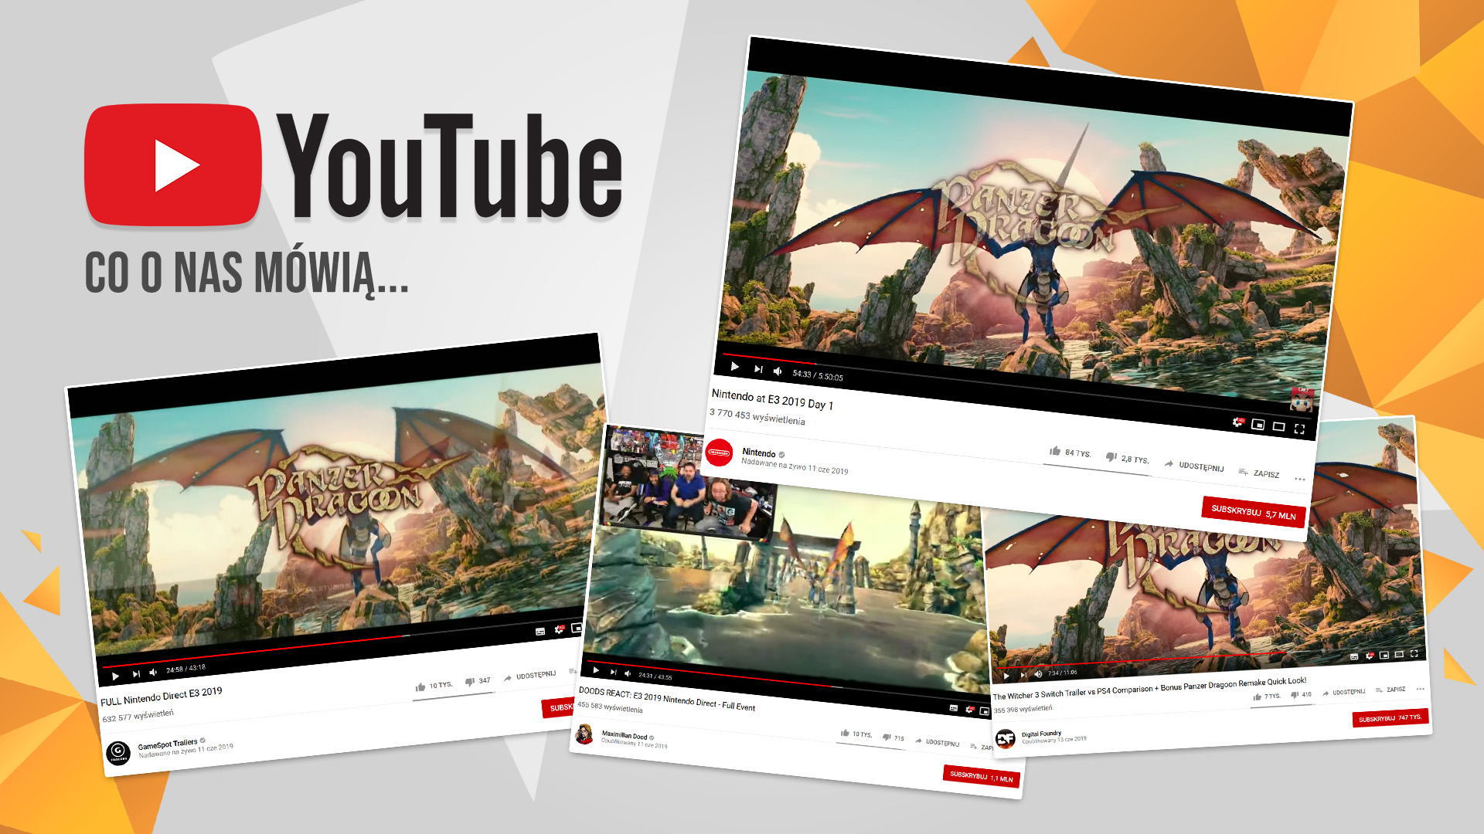

Slide 16
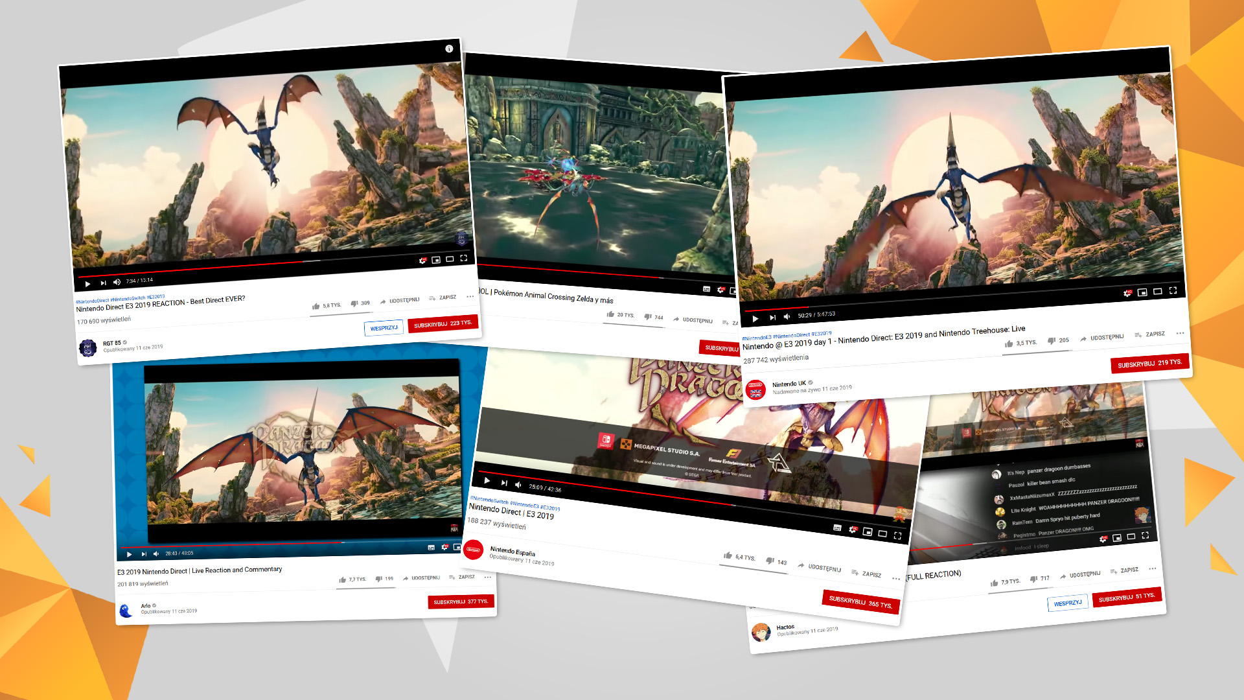

Slide 17
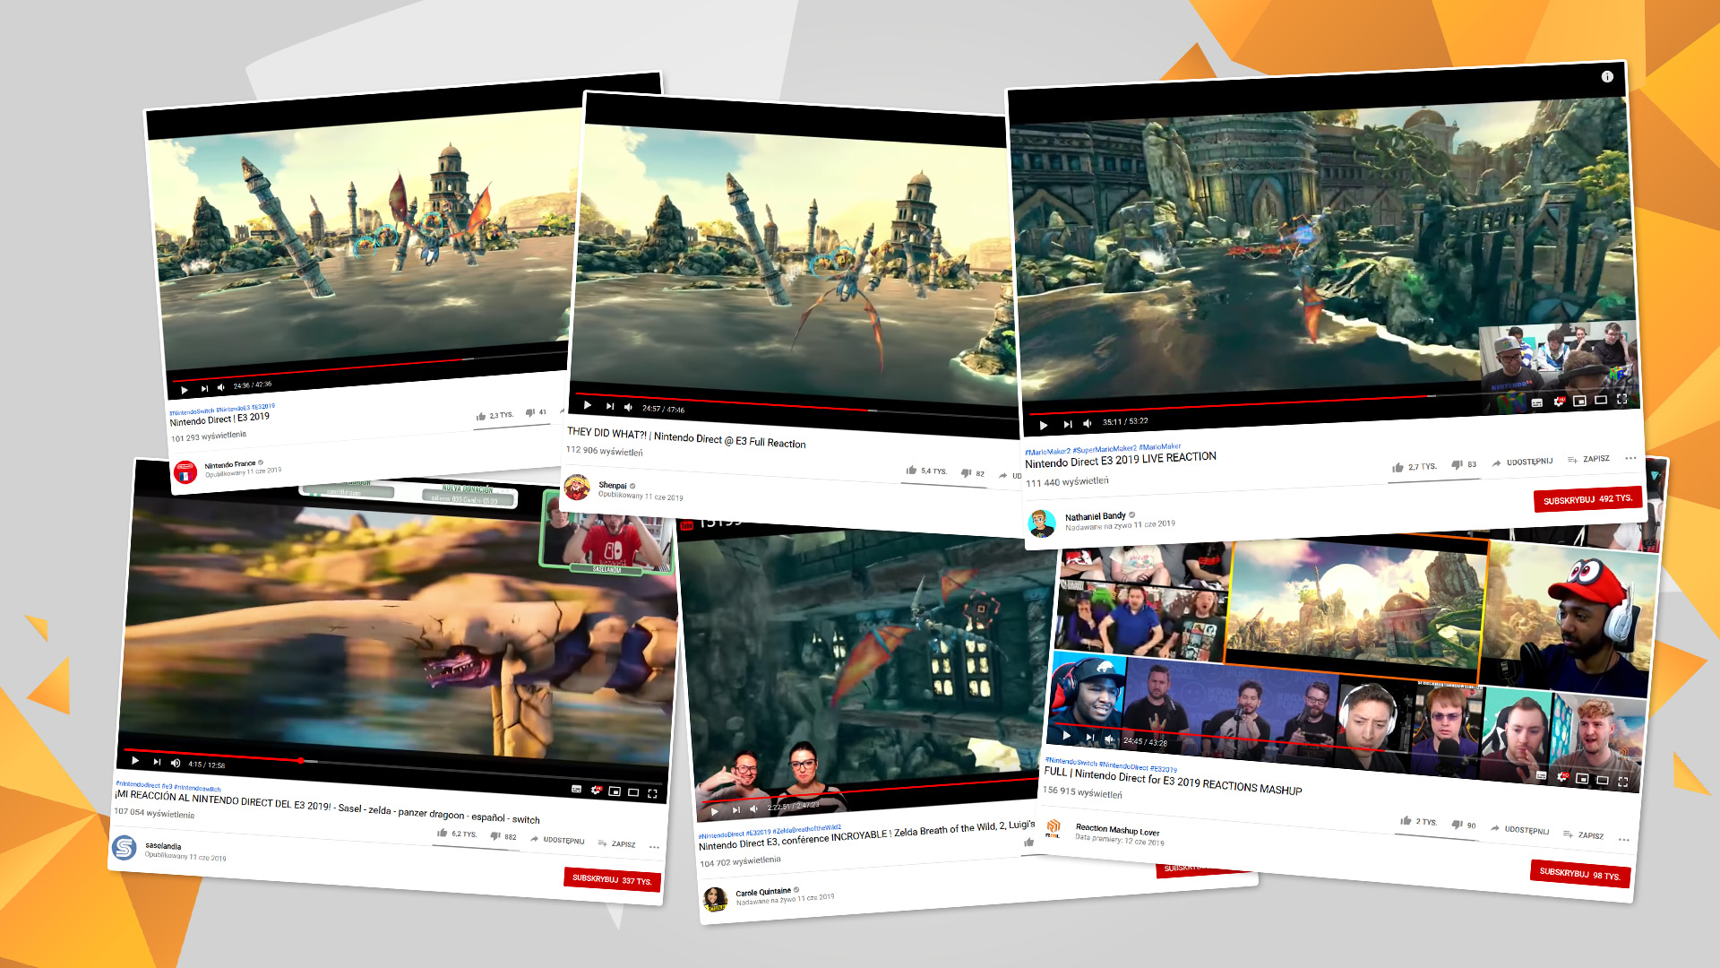

Slide 18
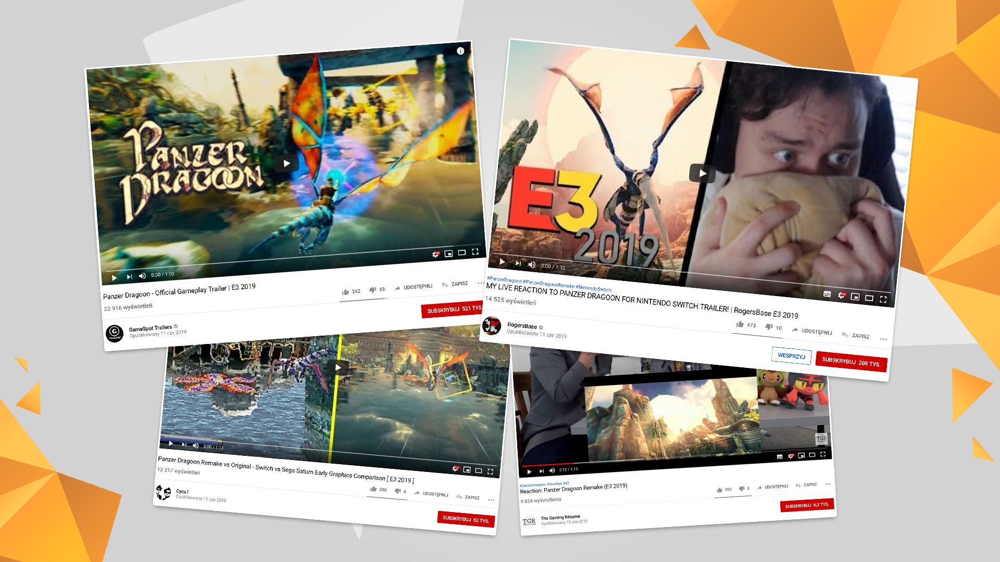

Slide 19
Panzer Dragoon: Remake reakcje na trailer:
https://youtu.be/3MRiEDWnnsk

Slide 20


Slide 21
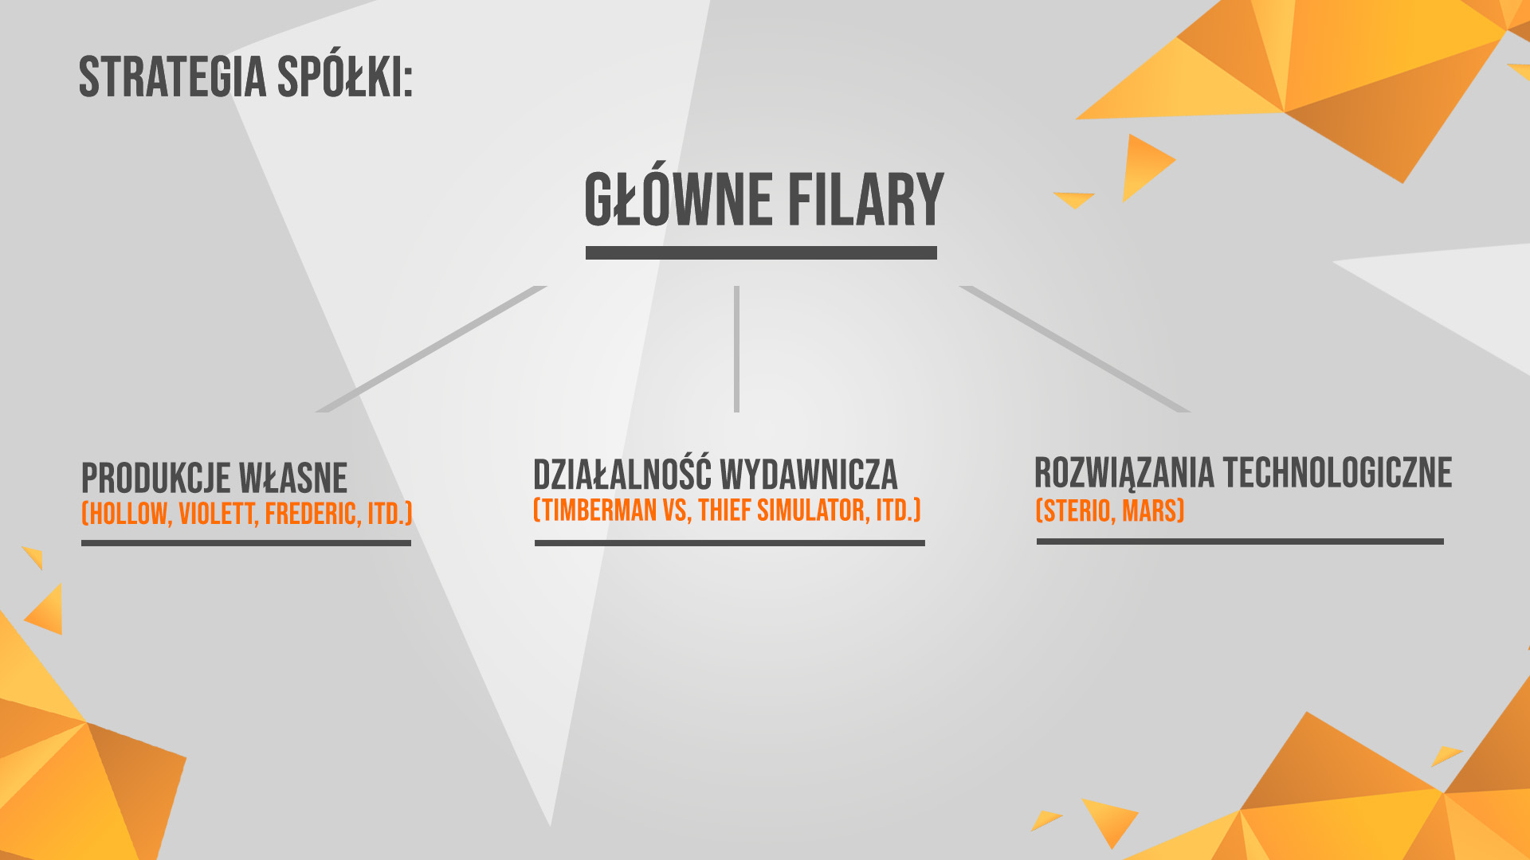

Slide 22
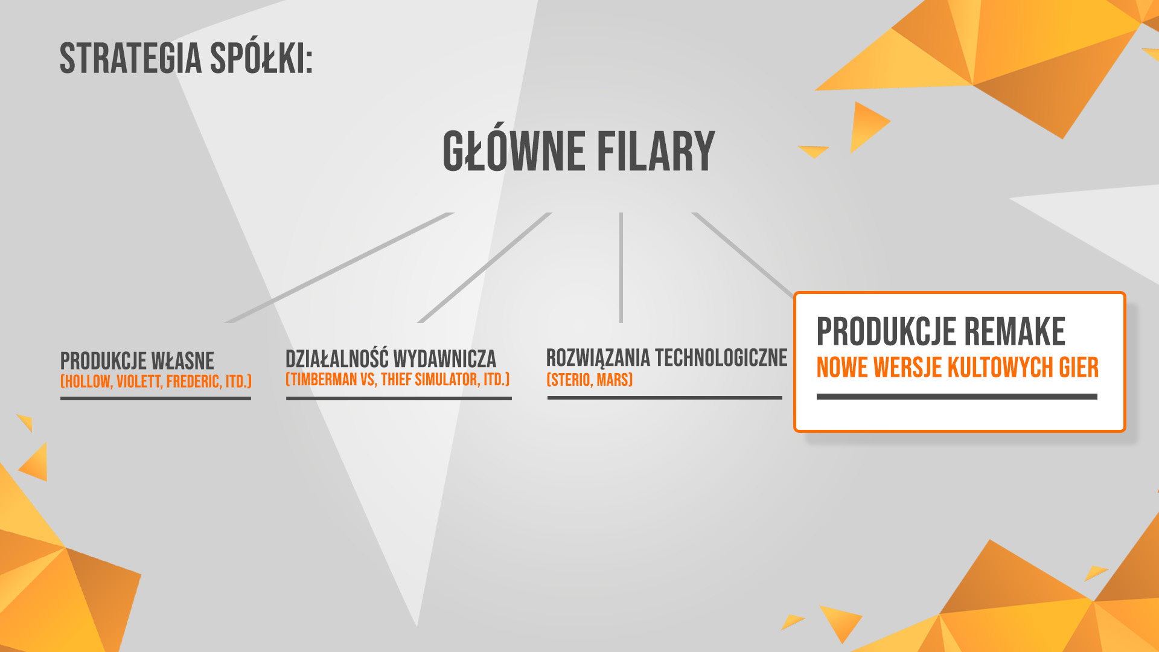

Slide 24


Slide 25


Slide 26


Slide 27


Slide 29
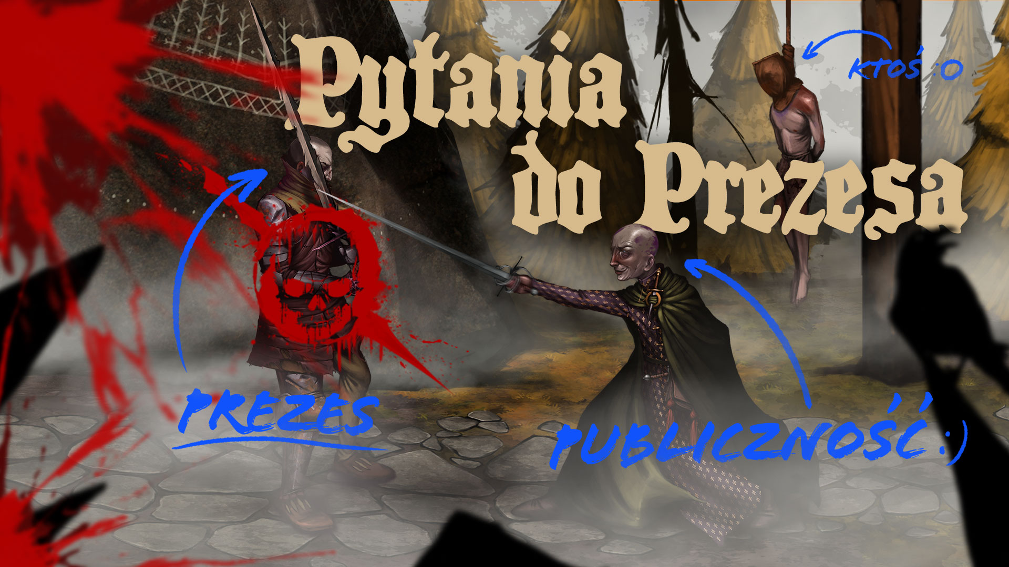

Slide 31


